Slide 1


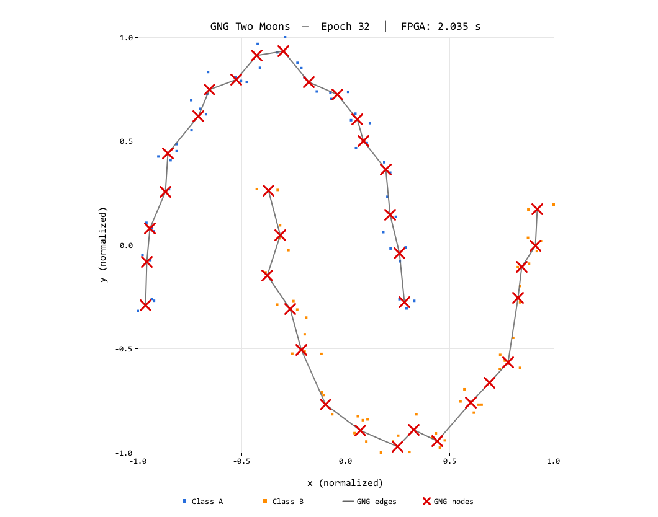
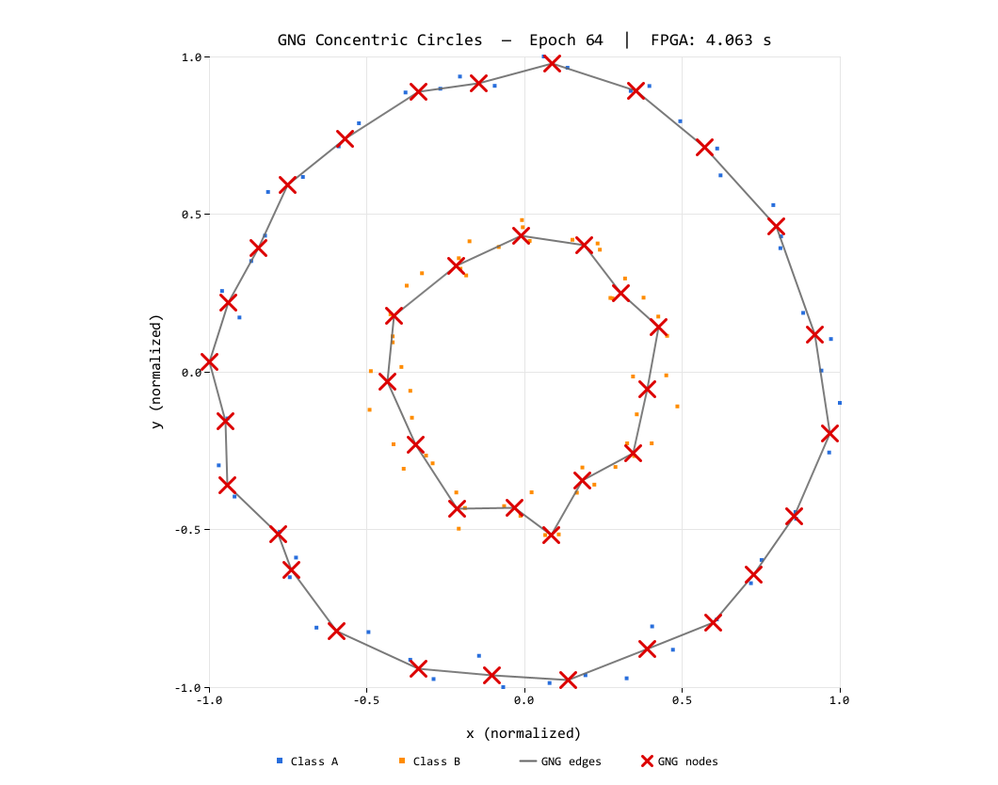
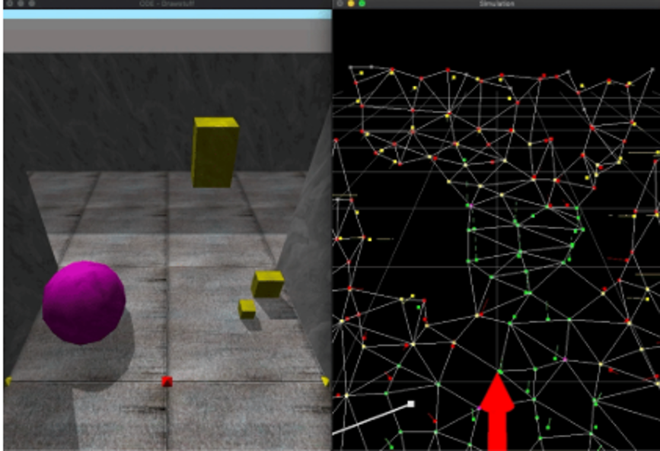
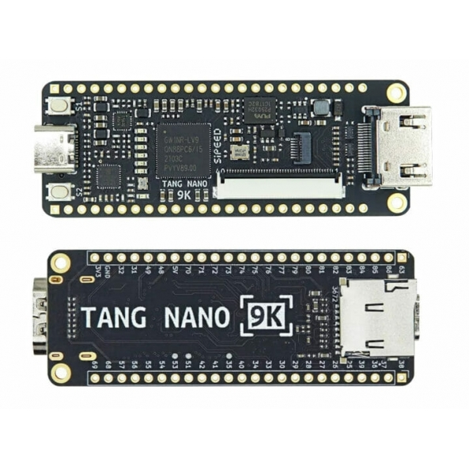
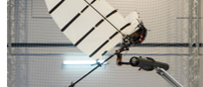

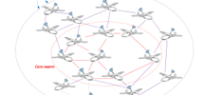
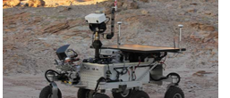
IEEE WCCI 2026 · MAASTRICHT, NETHERLANDS · 21–26 JUNE 2026 · POSTER SESSION
Edge-Cell Graph Encoding and Fixed-Point Arithmetic for FPGA Growing Neural Gas
Bringing unsupervised learning down to the embedded level
Teuku Zikri Fatahillah¹ · Raditya Artha Rochmanto^{1,2} · Achmad Fahrul Aji^{1,2}
Anhar Risnumawan^{1,3} · Chyan Zheng Siow^{1,4} · Naoyuki Kubota¹
CODE & DATA
¹ Tokyo Metropolitan University, Japan · ² Politeknik Negeri Semarang, Indonesia
github.com/tzf230201/fpga_gng
−41%
³ Politeknik Elektronika Negeri Surabaya, Indonesia · ⁴ Changsha Cultural and Creative Arts Vocational College, China
~625 µs
38%
smaller graph-state memory (2,000 B → 1,180 B)
deterministic latency / sample (≈1,600 / s)
LUT used on a 9K FPGA — 62% headroom left
1 · Motivation & Problem
CORE METHOD
6 · Results — It Fits, and It Learns
Micro-UAV swarms and field robots need on-board unsupervised adaptation — streaming raw data to the cloud is impractical. Learning must run locally, with bounded memory and deterministic timing .
4 · Edge-Cell Encoding
38%
22%
24%
50%
Edges are undirected, so store only the upper triangle of the adjacency — one byte per node pair, coding presence and age together :
LUT · 3,205/8,640
FF · 1,408/6,693
BSRAM · 6/26
DSP · 5/10
Growing Neural Gas (GNG) learns topology incrementally, sample-by-sample, without labels — ideal for streaming data. But classic GNG clashes with small FPGAs:
Place-and-route on Gowin GW1NR-LV9QN88PC6 (Gowin EDA V1.9.12.01) — 62% LUT and 76% BRAM headroom remain for application logic.
node i →
node j →
0
0
1
2
3
4
5
1
3
1
0
0
0
cell = age + 1 (stored edge)
2
0
7
0
0
cell = 0 (no edge)
3
2
5
0
lower triangle + diagonal — never stored
4
0
1
Topologies learned on the FPGA , streamed via UART snapshots. Left: Two Moons (epoch 32). Right: Concentric Circles (epoch 64). 100 samples each, N_{max} = 40.
5
4
Topological mapping in action: a robot explores its surroundings (left) while GNG incrementally builds a graph mirroring the free-space topology (right) — applications like this need adaptation to run on the device itself: payload-, power-, and link-constrained.
Half-adjacency indexing — flatten the 2D upper triangle into one 1D array, row by row:
Two Moons (final)
Concentric Circles (final)
▸
Dense adjacency is O(N²): a 40×40 8-bit matrix = 1,600 B — it dominates the BRAM budget of a sub-10K-LUT device.
0
1
2
3
4
5
6
7
8
9
10
11
12
13
14
QE 0.146 · TE 0.01
QE 0.196 · TE 0.07
0,1
0,2
0,3
0,4
0,5
1,2
1,3
1,4
1,5
2,3
2,4
2,5
3,4
3,5
4,5
QE (quantization error) drops steadily on both datasets and TE (topological error) stays near zero — the integer engine matches floating-point GNG quality. TE drifts slightly on Circles only after N _{max} saturates.
idx(i, j) =
i (2N_{max} − i − 1)
+ (j − i − 1)
(1,3) → cell 6
▸
Floating-point needs FPU blocks or slow iterative units — integer-only datapaths map cleanly to LUTs and DSPs.
2
7 · Deterministic Real-Time Throughput
Implementation
Node
Edge
Total
~625 µs
~16.9k
~1,600
▸
Prior FPGA self-organizing work targets SOMs with static lattices — GNG's per-iteration edge insert/age/prune on a variable graph is the hard part.
Dense adjacency (baseline)
400 B
1,600 B
2,000 B
per sample
cycles @ 27 MHz
samples / s
Edge-cells (proposed)
400 B
780 B
1,180 B
Measured from an on-chip 32-bit cycle counter embedded in every debug frame — Two Moons: 16,852 cycles (624.1 µs); Circles: 16,931 cycles (627.1 µs). Latency is dominated by the two O(N _{max}) BRAM scans — bounded and near-identical across datasets .
2 · Method Overview
−51.25% edge storage · −41% total graph state at N_{max} = 40 — freeing BRAM for application logic.
A fully integer, single-FSM GNG engine in synthesizable VHDL on the Sipeed Tang Nano 9K (Gowin GW1NR-9C) — no soft-core CPU, no FPU, no PLL.
5 · Fixed-Point Arithmetic
8 · Takeaway & Future Work
i
Edge-cell encoding — upper-triangular half-adjacency with 8-bit age+1 cells: 780 B vs 1,600 B edge storage.
Integer-only datapath — no floating-point unit. The whole engine runs on a Tang Nano 9K @ 27 MHz (single FSM, 3 BRAMs, UART 1 Mbit/s).
Self-organizing clustering with dynamic topology is feasible on a sub-10K-LUT FPGA — when memory layout and arithmetic format are treated as first-class design concerns. Bounded state + incremental updates make this a hardware substrate for continual learning at the edge .
ii
Shift-based Q8/Q16 learning rates — every adaptation step is one multiply + shift, single DSP cycle.
Tang Nano 9K · GW1NR-9C
iii
Fused NB_SCAN pass — error decay + edge aging + neighbor movement + pruning in one sequential sweep; no separate full-array decay pass.
Coordinate representation — 16-bit signed integers in [−1000, 1000] after min-max normalization:
PROSPECTIVE APPLICATIONS
x_{norm} =
(
x − x_{min}
)
· 2s − s ,
s = 1000
x_{max} − x_{min}
Aerial robot
Bio-inspired robot
Drone swarm
Exploration robot
iv
Per-node degree counters — O(N_{max} ) isolated-node detection without scanning the edge array.
80-bit node word — one BRAM entry per node:
x [16]
y [16]
deg [8]
err [32]
Streaming sensor input — adapt continuously without restart
Pipelined O(log N) winner-search tree
3 · GNG Loop & Parameters
Squared-distance unit — maps directly onto a 9×9 DSP multiplier, overflow-free:
Q-format precision via VHDL generics
Multi-stream on-board unsupervised mapping
①
Find winner s₁ = argminᵢ ‖ξ − wᵢ‖² and runner-up s₂.
Δx = ξ_{x} − x_{n} , Δy = ξ_{y} − y_{n} 17-bit signed
②
Accumulate winner error; move s₁ toward ξ by ε_{w}.
d² = Δx² + Δy² 35-bit unsigned
③
Age edges of s₁; move its neighbors by ε_{n}; prune edges past A_{max}.
Parametric learning rates — one multiply + shift each (single DSP cycle):
④
Connect (s₁, s₂) with age 0; decay all errors by β.
Winner (Q8)
Δx
s₁
= ⌊
77 (ξ_{x} − x_{s₁})
⌋
ε_{w} ≈ 0.301
2⁸
⑤
Every λ samples: insert a node between the max-error node and its worst neighbor; split errors by α.
Neighbor (Q16)
Δx
n
= ⌊
66 (ξ_{x} − x_{n})
⌋
ε_{n} ≈ 0.001
2¹⁶
Parameter
Value
Hardware mapping
Multiplierless error decay
err −= err ≫ 8
no multiplier (β ≈ 0.9961)
Nₘₐₓ (max nodes)
40
node BRAM depth
Fused update: winner move, edge aging, neighbor move, error decay & pruning all run in one NB_SCAN sweep — independent per-edge ops, parallelizable on FPGA.
Aₘₐₓ (max edge age)
50
A_MAX_STORED = 51
λ (insertion period)
100
lambda_cnt counter
εw (winner lr)
≈ 0.301
EPS_WIN_Q8 = 77, ≫ 8
εn (neighbor lr)
≈ 0.001
EPS_N_Q16 = 66, ≫ 16
α (error split)
0.5
INS_ALPHA_SHIFT = 1
β (error decay)
≈ 0.9961
ERR_DECAY_SHIFT = 8
ERR_SHIFT (acc. scale)
4
d² ≫ 4 before accum.
Selected References
[1] B. Fritzke, “A growing neural gas network learns topologies,” NeurIPS, 1994.
[2] T. Kohonen, “Self-organized formation of topologically correct feature maps,” Biol. Cybern. , 1982.
[8] J. Holmström, “Growing neural gas with utility,” Neural Networks, 2002.
[16] P. Coelho et al., “FPGA implementation of self-organizing maps using fixed-point arithmetic,” J. Signal Process. Syst. , 2020.
[25] Piyasena et al., dynamically growing SO network (GWR-like) on FPGA for lifelong learning at the edge.
[26] Firmli et al., compressed sparse row (CSR++) for low-degree-graph memory reduction.
Supported by the Japan Science and Technology Agency (JST), Moonshot R&D Program, grant JPMJMS2034.
[email protected]

